Slide 1
Skill Learning: Understanding and Explaining Skills – Ivy
Presenter: Rochan Madhusudhana
Team: Ashok Goel, Spencer Rugaber, Rahul Dass, Rochan Madhusudhana, Jeanette Luu, Cherie Lum, Shashank Verma, Erin Deye
Notes:
Hello everyone! My name is Rochan, and today I’ll be presenting on understanding and explaining skills in the Ivy project.

Slide 2
Enhancing Online Education with Ivy
Problem Passive learning – reduces engagement and retention
Ivy’s Solution Embed intelligent coaches within online lecture videos for active skill learning
Goal Enhance teaching and cognitive presence
Notes:
So, we’ve seen in our panels and previous presentations this morning how there has been an exponential increase in demand for online education. Videos play a crucial role in this growth.
However, there is a major challenge with online videos: they often present information passively. What does this mean? It means that students typically watch the videos without actively engaging with the content. This can lead to a disengaged audience and, ultimately, reduced learning outcomes.
This is the problem we aim to solve with Ivy, which stands for interactive videos. We embed intelligent coaches directly within lecture videos. This approach not only presents information but actively involves learners through interactive exercises tailored to enhance skill learning and promote learning by doing.
Our goal is to make skill learning more effective and accessible for adults through these interactive videos. We aim to enhance both the teaching presence and the cognitive presence, creating a more engaging and impactful learning experience.

Slide 3
Theory of Learning and Change
Theory of Learning
Theory of Change
Ivy
More cognitive engagement
Better skill retention
Enhanced teaching presence
Better performance
Passive
Active
Constructive
Interactive
ICAP Theory¹
1: Chi, M. T., et al. (2018). Translating the ICAP theory of cognitive
engagement into practice. Cognitive science, 42(6), 1777-1832.​
Notes:
To understand Ivy’s impact, let’s delve into the theory of learning and change.
According to the ICAP theory, cognitive engagement progresses through four levels: passive, active, constructive, and interactive.
Plain videos represent a passive form of learning.
Our goal with Ivy is to elevate learners to more active and interactive forms of learning.
When successfully implemented, we anticipate several positive outcomes such as increased cognitive engagement, improved skill retention, enhanced teaching presence, and better performance.

Slide 4
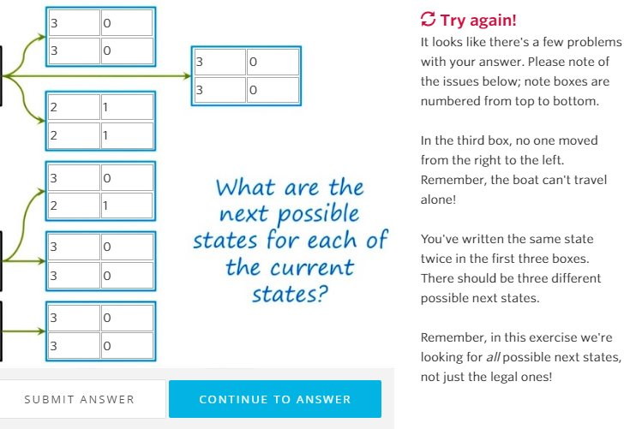
Initial Prototype of Ivy
Survey: 1. Students with tutors outperformed 2. 80% found tutors engaging & interactive²
Problems: 1. Ad-hoc approach used 2. Coupled with Udacity
Proposed Changes: 1. Model skills using a structured representation 2. Leverage Generative AI
1: Goel, A. K., & Joyner, D. A. (2017). Using AI to teach AI: lessons from
an online AI class. Ai Magazine, 38(2), 48-59. 2: Ou, C., Joyner, D. A., & Goel, A. K. (2019). Designing and developing
video lessons for online learning: A seven-principle model. Online
Learning, 23(2), 82-104.
Notes:
Now, Ivy, in its current form, is a relatively new project, and we’ve been working on it since last year.
However, it does have a bit of background to it.
The initial prototype was developed in Fall 2014 for a Knowledge-Based AI course on Udacity. It used interactive exercises and provided dynamic feedback.
To assess the effectiveness of this system, a survey was conducted.
The survey showed promising results where students with Ivy performed better and 80% of students found the tutors engaging.
However, there were some issues with these early tutors.
Firstly, they used hard-wired rules and had no representation of skills. This limited their capacity and made it almost impossible to transfer them to other classes.
Secondly, their functionality was tightly coupled with the Udacity platform.
To address these challenges, we’ve since developed a new platform that’s independent of any LMS but can be embedded within them, like Ed Lessons.
We’ve also changed our approach. Instead of using an ad-hoc method, we now explicitly model skills using a structured skill representation and combine that with Generative AI to provide answers.

Slide 5
Structured Skill Representation
TMK Model
Example Model
Skill: Email Usage
Skill
Task
Method
Knowledge
Compose an email
Task
1. Open email client 2. Click "Compose" 3. Enter address, subject, body 4. Click "Send"
Method
1. Computer Skills 2. Typing Skills 3. Internet Usage 4. Recipient's Address
Knowledge
Notes:
Now, how could we represent the knowledge we are going to answer questions about? One way we thought, was to use a knowledge representation that features things relevant to the skill at question. This is our skill representation format called TMK. It stands for Task-Method-Knowledge.
In this representation, we break down a skill into its constituent tasks, the methods to achieve those tasks, and the prerequisite knowledge required to perform the tasks.
To better illustrate TMK, let’s consider a simple example: the skill of ‘Using Email.’
One of the tasks could be to compose an email. To achieve this task, we use the following methods: ‘Opening the email client,’ ‘Clicking compose,’ ‘Typing in the receiver’s address, subject, and message body,’ and finally ‘Clicking send.’
To perform this task, we must be familiar with certain knowledge terms, such as basic computer usage and typing skills.
It is important to note that TMK can be hierarchical. For instance, while ‘Computer Skill’ is a prerequisite knowledge for using email, it can also be modeled as its own TMK. This hierarchy gives us the flexibility and building blocks to compose and understand more complex topics.

Slide 6
New Implementation of Ivy
Cognitive AI
Response
Gen AI
Classify T/M/K/Multi
Localize / Simulate
Natural Language Response
Notes:
The TMK model represents the Cognitive AI side of Ivy.
However, the true strength of Ivy emerges when we combine this Cognitive AI with generative AI.
When a user asks a question, we use the TMK model as a reference to classify the question. We then identify the relevant parts or simulate the relevant processes. Finally, we use generative AI techniques, such as LLMs, to create a natural language explanation.
This combination allows Ivy to provide accurate and contextually relevant responses.

Slide 7
Results – Example Responses
“Classification” TMK
Example Question
1. Solve concept hierarchies 2. Generate next percept 3. Check percept values
Task
1. set_up_problem() 2. generate_percept() 3. solve_hierarchies()
Method
1. Concept Hierarchies 2. Equivalence Class 3. Superclass/Subclass
Knowledge
What is an Equivalence Class?
An Equivalence Class is an abstraction of a collection of percepts and their values, representing a superclass of related entities. It can also be understood in relation to subclasses…
Notes:
Now, let’s look at some example responses from Ivy.
At a high level, our system handles factual questions, which pertain to semantic knowledge, and applied questions, which pertain to episodic knowledge.
Let’s consider a simple factual question as an example.
On the left, we have a simplified TMK model for the skill of ‘Classification’ from the KBAI course.
We have a few tasks, the methods to achieve those tasks, and the required knowledge terms.
When we ask ‘What is an equivalence class?’, Ivy responds clearly and provides an answer in the context of the skill.
Firstly, Ivy identifies it as a question related to the Knowledge Component. It then looks up the definition of ‘Equivalence Class’ to generate an answer. Additionally, it looks up related knowledge terms, such as ”Subclass” to enhance its answer.

Slide 8
Results – Example Responses
“Classification” TMK
Example Question
Steps to solve the concept hierarchies problem
The task is broken down into subtasks and transitions… 1. We successfully set up the concept hierarchies problem. This data condition transitions us from the 'set up the problem' subtask to the 'generate the next percept' subtask. 2. ...
1. Solve concept hierarchies 2. Generate next percept 3. Check percept values
Task
1. set_up_problem() 2. generate_percept() 3. solve_hierarchies()
Method
1. Concept Hierarchies 2. Equivalence Class 3. Superclass/Subclass
Knowledge
Notes:
Now that we saw a simple example, let’s consider another slightly more involved example. We have the same TMK as before. But now, we now ask the system, “How to solve a problem?”
Now, Ivy identifies that this is a “task” related question. It then looks up the relevant task and then finds the associated methods to solve this particular task. In our case, it involves steps like setting up the problem, then generating the next percepts, and so on. Finally, it stitches them all this information together to provide the student with a step-by-step algorithm to solve the problem.
If, instead of a “How to solve” question, we had asked it a “What would happen if I did X” type of episodic knowledge-based questions, then Ivy simulates the scenario with the provided inputs to generate a derivational knowledge trace. It then tries to reason over the trace using LLMs to provide an answer.

Slide 9
Next Steps for Ivy
Automate TMK Creation
Use Gen-AI to automatically create TMK
Splice Into Videos
Integrate videos + QA into a single platform
Deploy In Class
Test in a live class in Jan 2025
Notes:
Finally, let’s discuss the next steps for Ivy.
Firstly, we aim to automate the creation of TMK models using Generative AI methods. At present, we manually develop these models for each skill, which is time-consuming. We are experimenting with ways to automatically generate TMK models directly from lecture materials and videos, significantly speeding up the process and improving scalability.
Secondly, we want to splice Ivy coaches directly into videos. Currently, videos play separately from the exercises. Our goal is to unify them into a single interactive video experience, where learners can engage with exercises within the video context itself.
Thirdly, we plan to deploy Ivy in an OMS class on AI in January 2025. With this, we hope to measure dependent variables mentioned in the Theory of Change, such as cognitive engagement, skill retention, teaching presence, and performance, to evaluate Ivy’s effectiveness.

